Slide 1
IBM University Engagement Project Submission
“Exploring the Power of Agentic AI with IBM Granite and IBM Bob”

Slide 2

Project Tile – Travel Planner Agent
Domain of Project – Artificial Intelligence (AI) & Travel Technology
Student Name | Recent Passport Photo | Email ID | Mobile number [WhatsApp]
YARRAMSETTY NAVEEN SRI KRISHNA |  | naveensrikrishnayarramsetty@gmail.com | 7416251249

Slide 3
Problem Statement -Travel Planner Agent
Challenge
• Complex travel planning
• Information spread across multiple platforms
• Difficulty managing budget and preferences
• Changing weather and travel conditions
• Time-consuming itinerary planning
Objective
• Build an AI-powered Travel Planner Agent
• Use IBM Granite for intelligent planning
• Create personalized travel itineraries
• Optimize budget, routes and schedules
• Adapt plans using real-time information

Slide 4
Proposed Solution: An AI-powered Travel Planner Agent that simplifies travel planning by combining user preferences, real-time data, and intelligent recommendations using IBM Granite.
• Understands user preferences, budget and travel requirements
• Recommends suitable destinations based on user interests
• Generates personalized day-wise travel itineraries
• Suggests suitable transport and accommodation options
• Integrates weather, maps and local attraction information
• Estimates and optimizes the overall trip cost
• Adjusts the itinerary when weather or travel conditions change
• Provides a simple and interactive travel planning experience
• Uses IBM Granite for AI-powered reasoning and recommendations
• Deployed using IBM Cloud services for a scalable solution

Slide 5
Technology Used :
IBM Bob platform -For designing and orchestrating multi-agent workflows visually
IBM Grainte model - for eg – ibm-granite-4 – For natural language understanding, reasoning, and personalization
IBM Cloud – It provides the infrastructure to build, deploy, and scale the Nutrition Agent efficiently. IBM Cloud enables a reliable, secure, and scalable environment for deploying the Nutrition Agent.

Slide 6
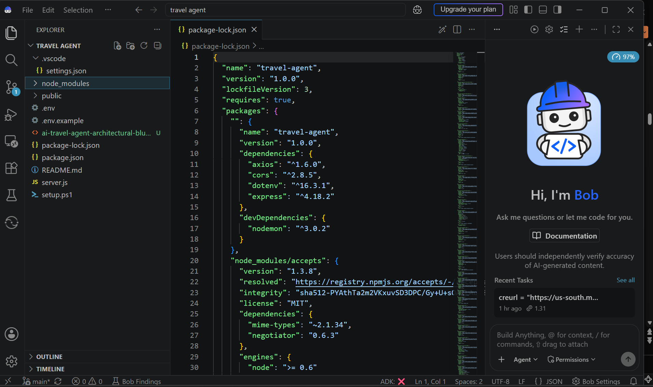
Required Files created using IBM bob -

Slide 7
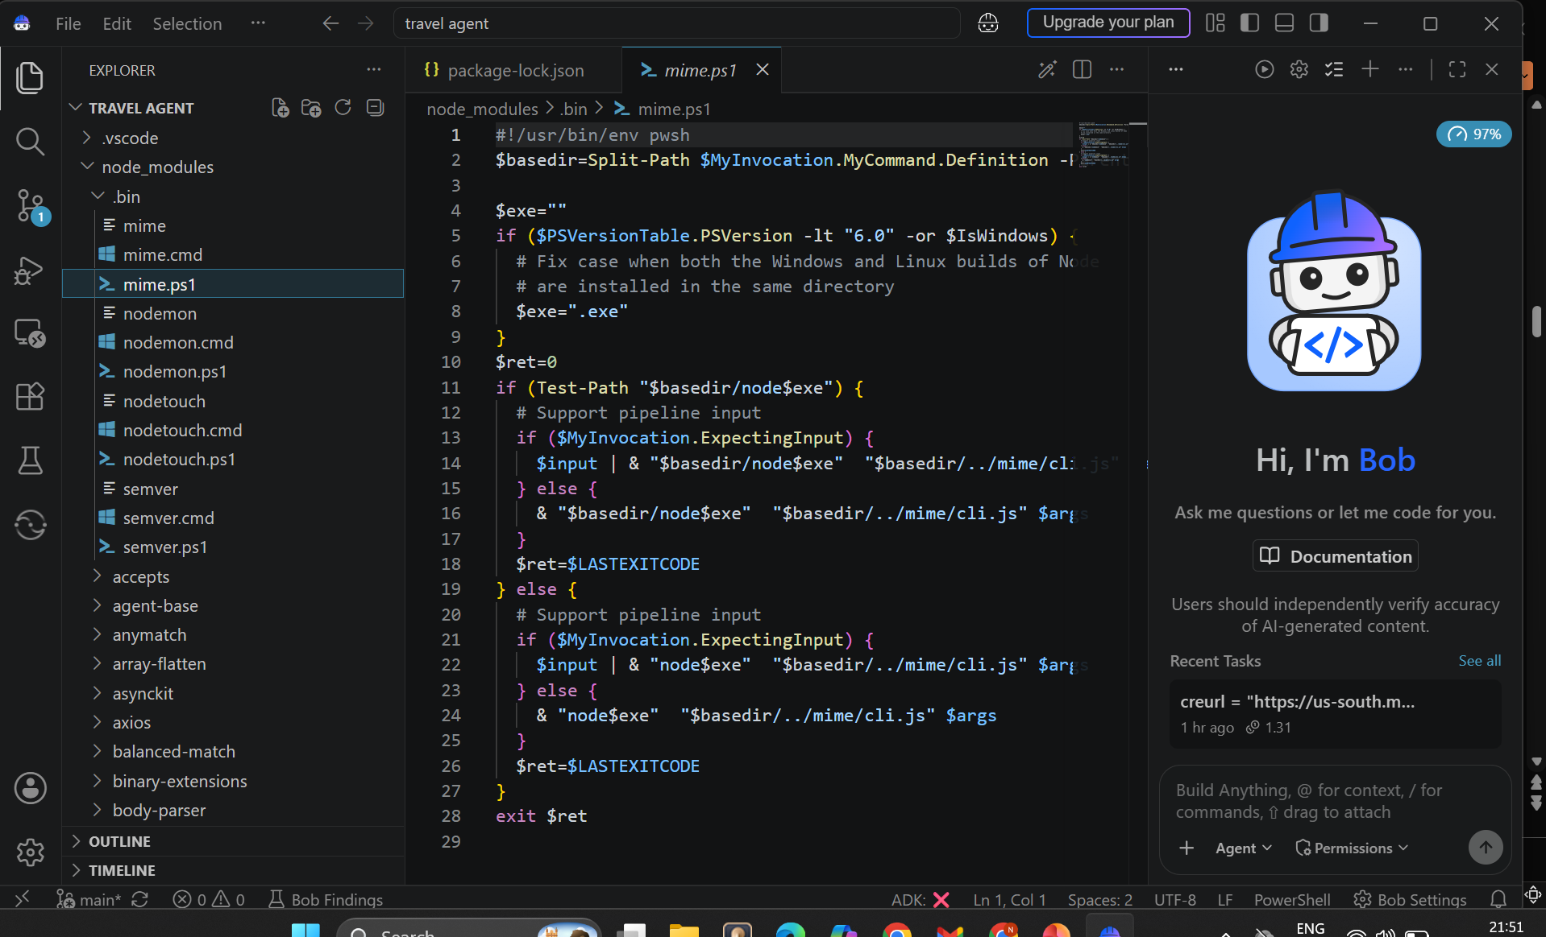
IBM Bob Screenshots:

Slide 8
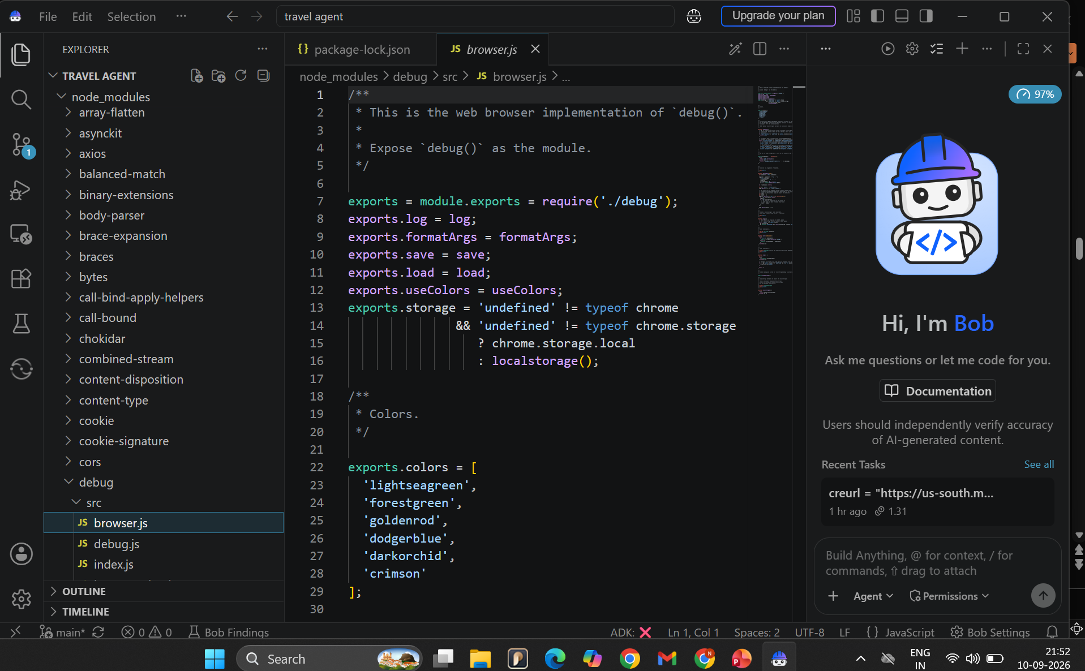

Slide 9
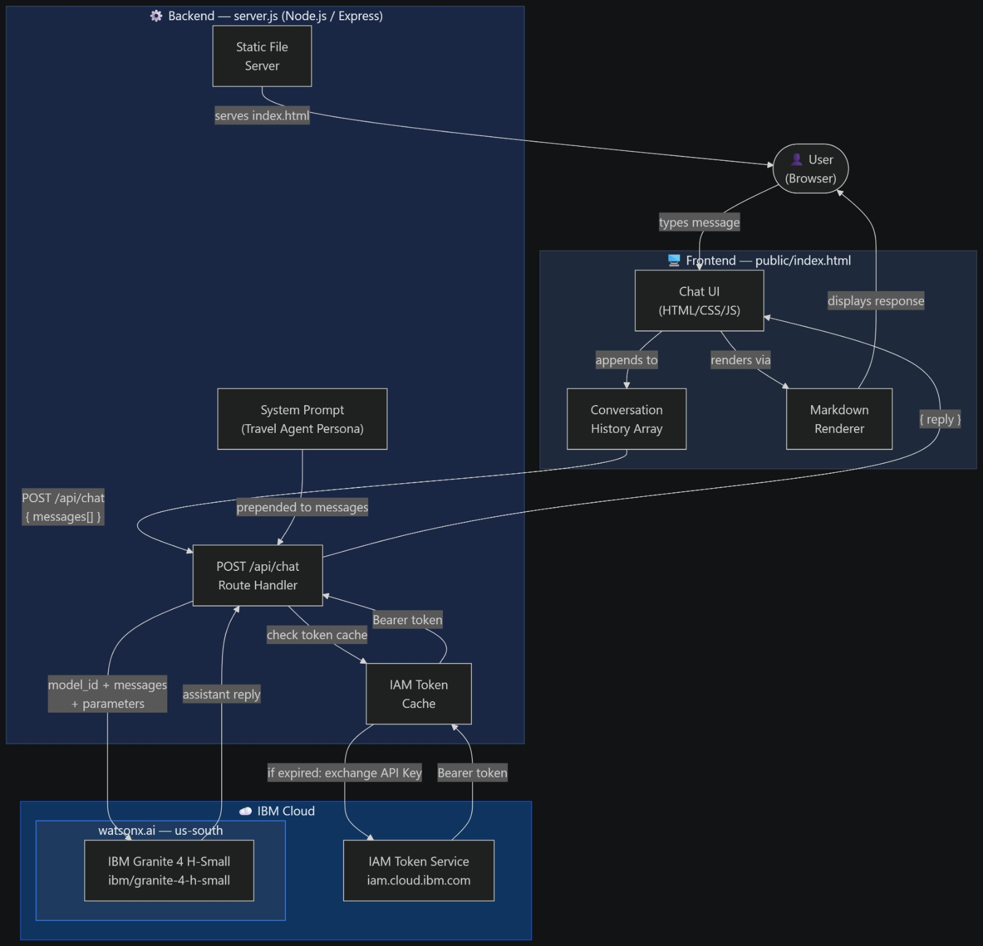
Architecture blueprint for IBM bob:

Slide 10
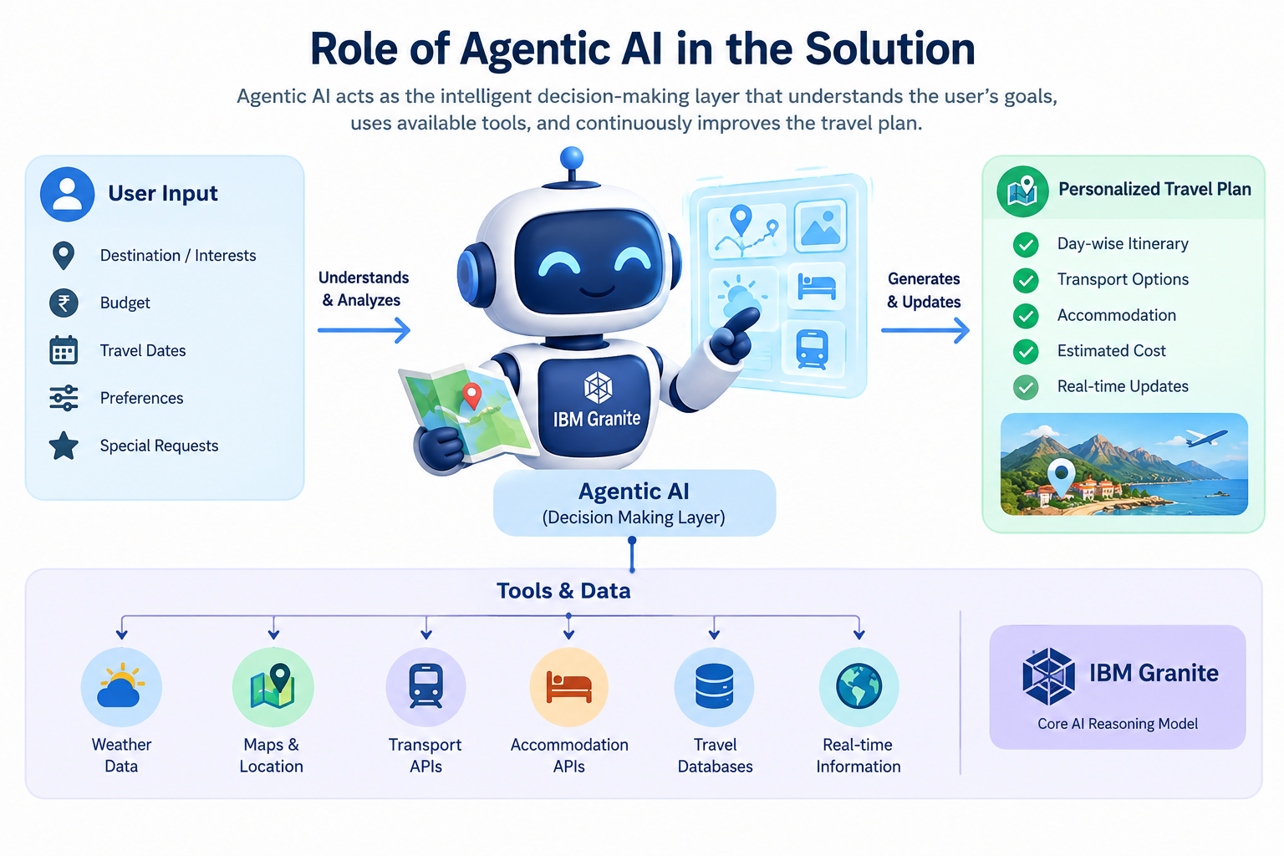
Role of Agentic AI in the solution
Agentic AI acts as the intelligent decision-making layer that understands the user's goals, uses available tools, and continuously improves the travel plan.
• Understands user goals, preferences and constraints
• Analyzes travel requirements and makes decisions
• Uses weather, maps and travel data through external tools
• Selects suitable destinations, transport and accommodation
• Creates and optimizes personalized itineraries
• Checks the plan against budget and time constraints
• Detects changes in weather or travel conditions
• Automatically replans the itinerary when required
• Provides intelligent, context-aware travel recommendations
• Uses IBM Granite4 as the core AI reasoning model

Slide 11
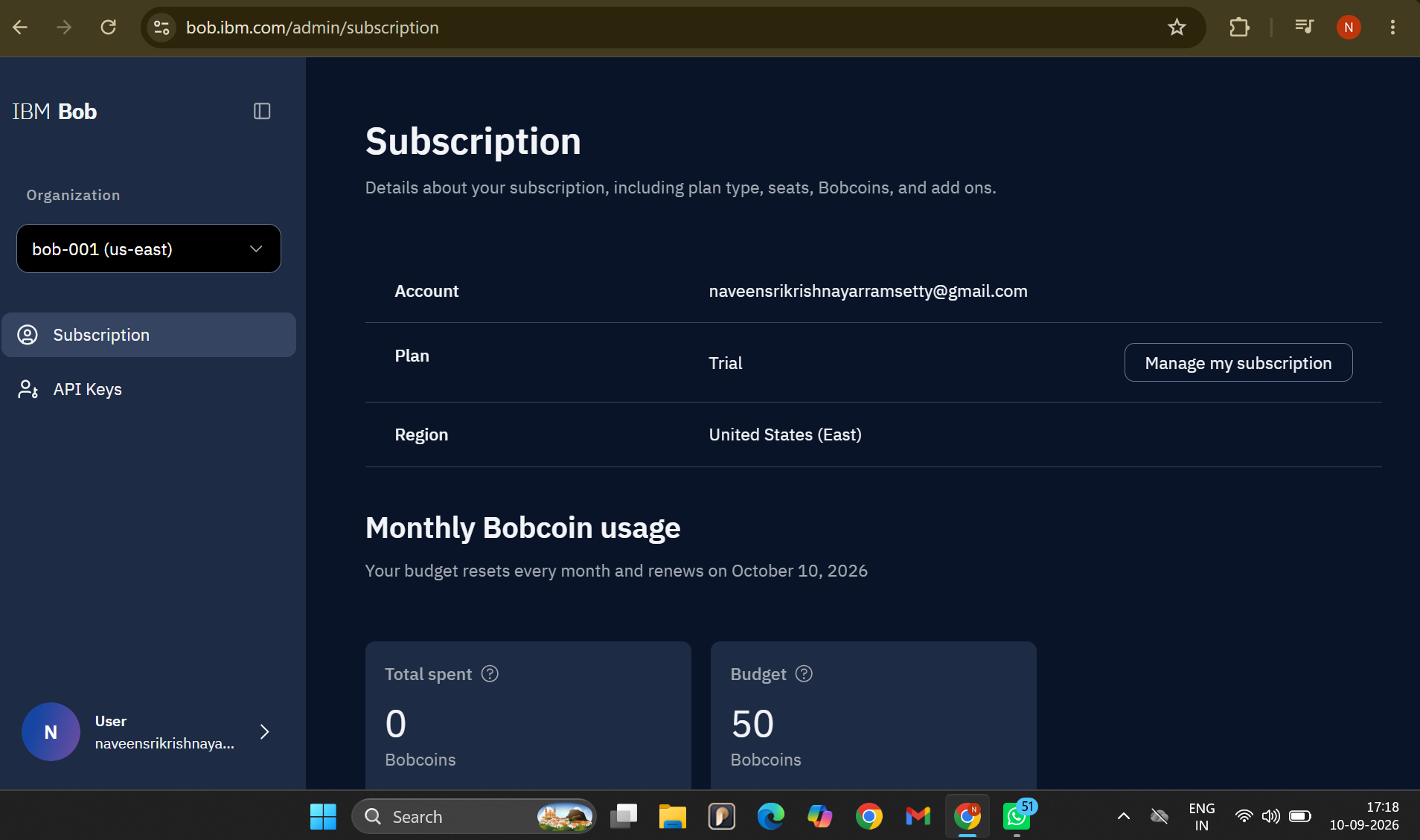
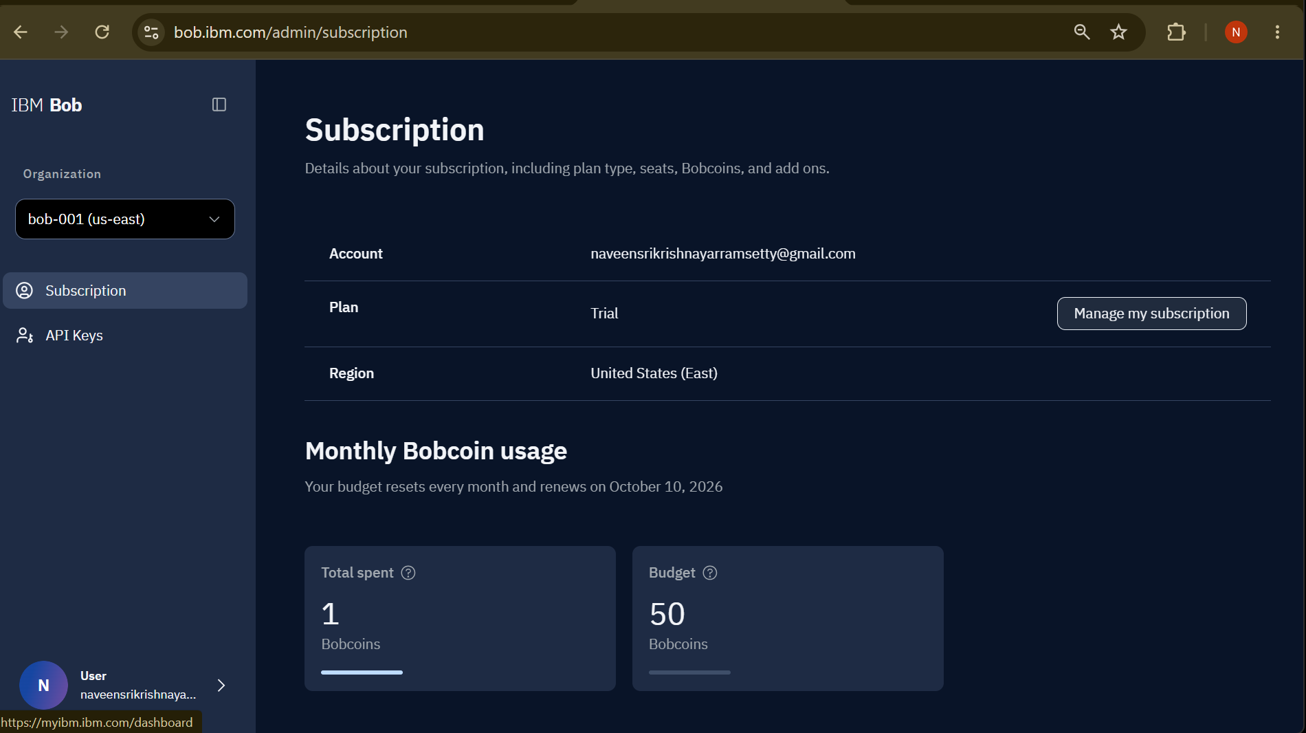
Token Usage
Before Prompt
After the Prompt
·
·
·

Slide 12
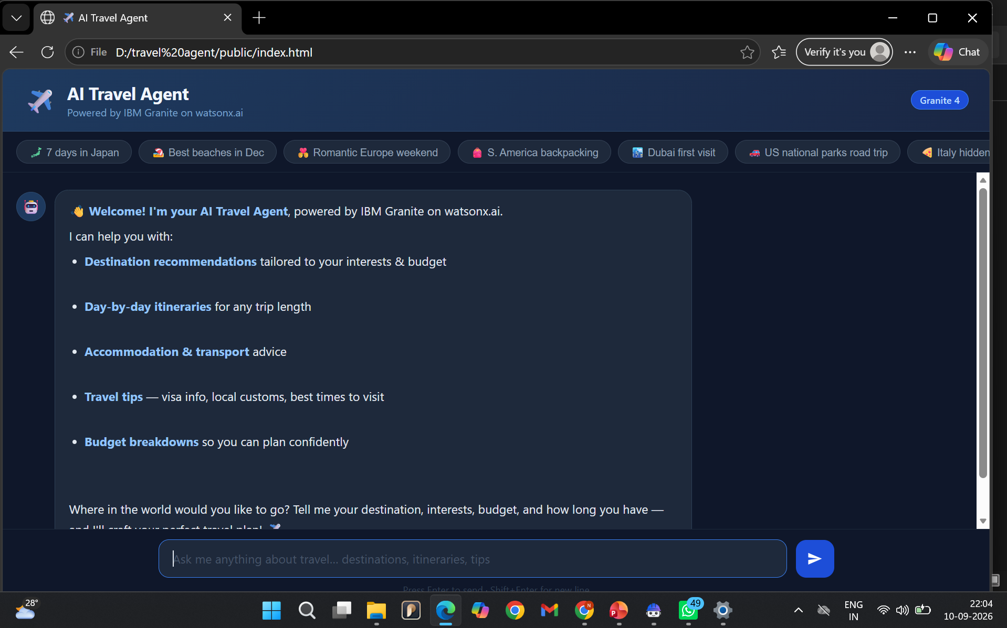
Project Output Screenshot
·
·
·

Slide 13
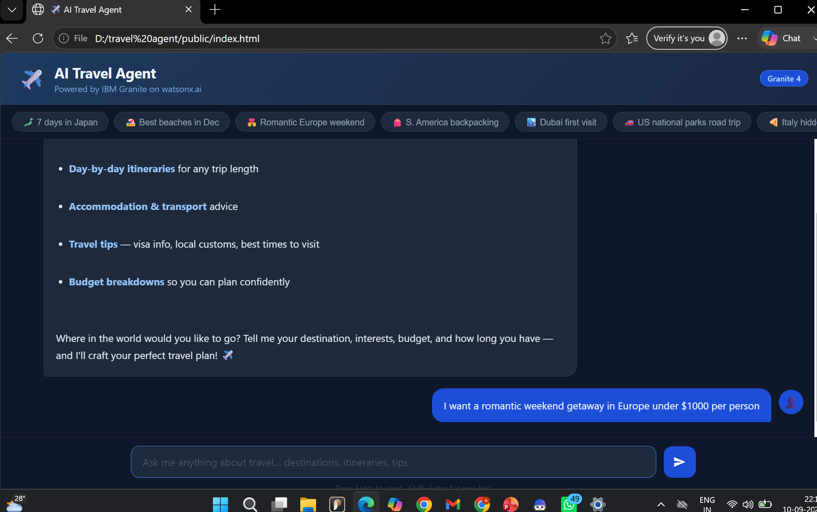
Project Output Screenshot
·
·
·

Slide 14
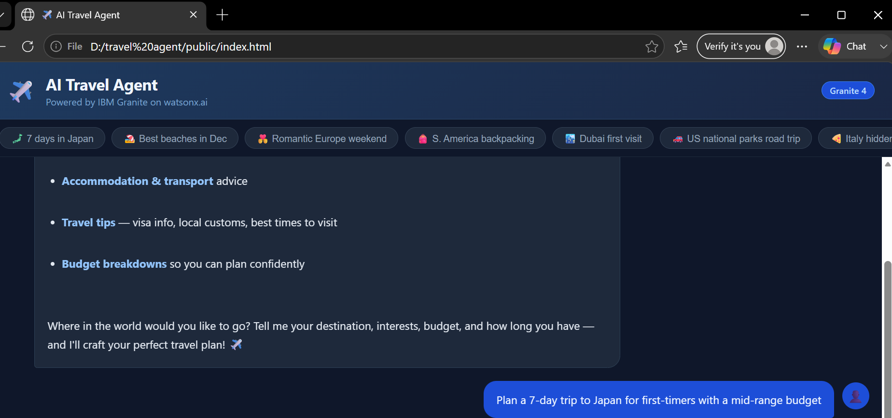
Project Output Screenshot
·
·
·

Slide 15
Novelty and Uniqueness
The proposed Nutrition Agent stands out by combining Agentic AI, and personalization into a single intelligent system.
An intelligent travel agent that goes beyond simple itinerary generation by continuously adapting plans to user needs and real-time conditions.
• AI-driven personalized travel planning
• Dynamic itinerary generation and optimization
• Budget-aware recommendations and cost optimization
• Real-time weather and travel condition awareness
• Automatic itinerary updates when conditions change
• Combines multiple travel services through AI agent tools
• IBM Granite-powered intelligent decision making
• One unified platform for end-to-end trip planning

Slide 16
Git Hub Link : https://github.com/NSK-Y/travel-agent.git
·
·
·

Slide 17
Future Scope
Real-Time Booking: Enable direct booking of flights, hotels, and transportation.
Dynamic Itinerary: Automatically update plans based on weather, traffic, delays, or cancellations.
Voice-Based Planning: Allow users to plan trips using voice commands.
Multi-Agent System: Use specialized AI agents for hotels, transport, budget, weather, and activities.
Personalized Recommendations: Learn from user preferences and previous trips.
Advanced Cost Optimization: Find the best travel options based on budget and price changes.
·
·
·

Slide 18
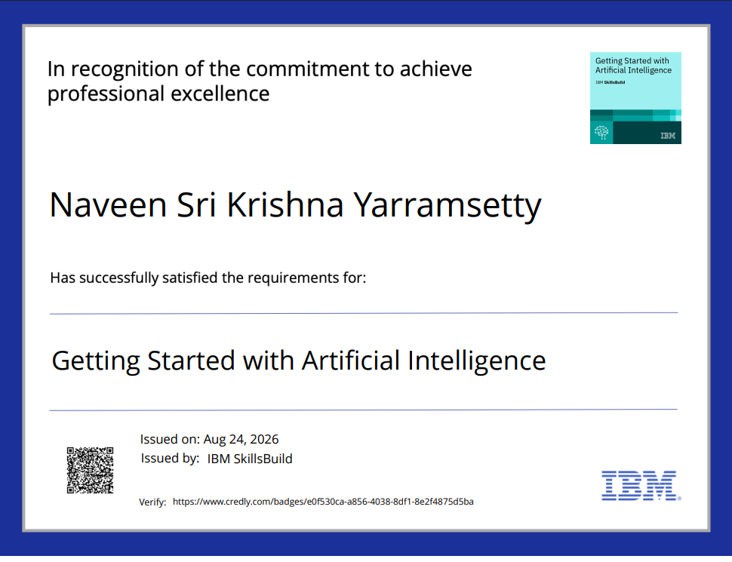
Certificates Earned: Getting Started with Artificial Intelligence

Slide 19
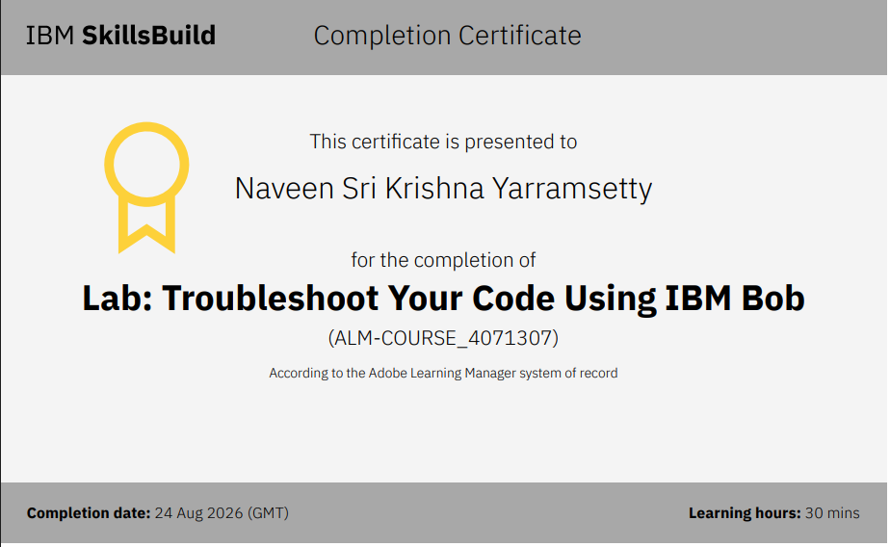
Certificates Earned:​
IBM BOB Certificate

Slide 20


